Slide 1
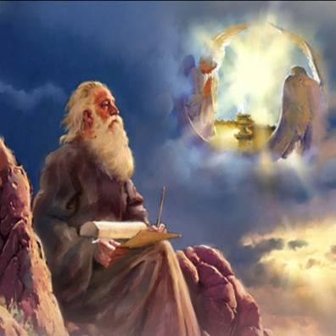
Apocalyptic Genre and Inerrancy
Dr. Andy Woods
Artwork by Pat Marvenko smith, copyright 1992 is from a series titles “Revelation Illustrated: and has been used by permission. It is available in fine art prints and visual teaching materials. Call 1-800-327-7330 for a free brochure, or go to www.revelationillustrated.com. Artwork by Duncan Long is copywriten and used by permission. For more information: duncan@duncanlong.com (or call at 785-776-6186)

Slide 2
Charles Ryrie Dispensationalism Today, Page 86
Charles Ryrie specifically notes that literalism "does not preclude or exclude correct understanding of types, illustrations, apocalypses, and other genres within the basic framework of literal interpretation.”

Slide 3
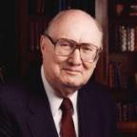
Dr. John Walvoord "An Interview: Dr. John Walvoord Looks at Dallas Seminary," Dallas Connection (Winter 1994, Vol. 1, No. 3), p. 4.
In 1994, "What do you predict will be the most significant theological issues over the next ten years?" He responded, "The hermeneutical problem of not interpreting the Bible literally, especially the prophetic areas. The church today is engulfed in the idea that one cannot interpret prophecy literally.”

Slide 4
Apocalyptic Genre and Inerrancy
The New Approach
Apocalyptic Classification
Hermeneutical Doors
Weaknesses
The Traditional Approach
Prophecy Classification
Consistent literalism
Symbolic Language?

Slide 5
Apocalyptic Genre and Inerrancy
The New Approach
Apocalyptic Classification
Hermeneutical Doors
Weaknesses
The Traditional Approach
Prophecy Classification
Consistent literalism
Symbolic Language?

Slide 6
Apocalyptic Genre and Inerrancy
The New Approach
Apocalyptic Classification
Hermeneutical Doors
Weaknesses
The Traditional Approach
Prophecy Classification
Consistent literalism
Symbolic Language?

Slide 7
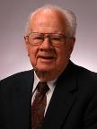
J. Dwight Pentecost
“Daniel,” in Bible Knowledge Commentary, ed. John F. Walvoord and Roy B. Zuck (Colorado Springs, CO: Victor, 1985), 1323.
“Apocalyptic literature in the Bible has several characteristics: (1) In apocalyptic literature a person who received God’s truths in visions recorded what he saw. (2) Apocalyptic literature makes extensive use of symbols or signs. (3) Such literature normally gives revelation concerning God’s program for the future of His people Israel. (4) Prose was usually employed in apocalyptic literature, rather than poetic style which was normal in most prophetic literature. In addition to Daniel and Revelation, apocalyptic literature is found in Ezekiel 37–48 and Zechariah 1:7–7:8. In interpreting visions, symbols, and signs in apo­ca­­lyp­tic literature, one is seldom left to his own ingenuity to discover the truth. In most instances an examination of the context or comparison with the parallel biblical . . .

Slide 8
J. Dwight Pentecost
“Daniel,” in Bible Knowledge Commentary, ed. John F. Walvoord and Roy B. Zuck (Colorado Springs, CO: Victor, 1985), 1323.
. . . passages provides the Scriptures’ own interpretation of the visions or the symbols employed. Apocalyptic literature then demands a careful comparison of Scripture with Scripture to arrive at a correct understanding of the revelation being given.”

Slide 9
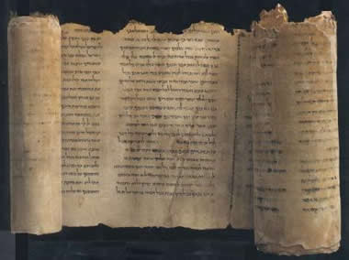
Apocalyptic Books
Enoch
Apocalypse of Baruch
Jubilees
Assumption of Moses
Psalms of Solomon
Testament of the Twelve Patriarchs
Sibylline Oracles

Slide 10
COMMON CLUSTER OF CHARACTERISTICS: REVELATION & APOCALYPTIC BOOKS
Written 200 B.C. - A.D. 100 | Vision is means of revelation
Angels featured as interpreters & guides | Focus upon current age and inauguration of age to come.
Written during intense time of persecution | Dualism with God and Satan
Use of vivid images and symbols | Spiritual order determines human history
Struggle between good and evil | Pessimistic about man’s ability to change progress of events

Slide 11
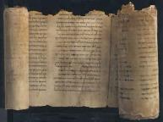
Apocalyptic Books
Extensive use of symbolism
Vision as the major means of revelation
Angelic guides
Activity of angels and demons
Focus on the end of the current age and the inauguration of the age to come
Urgent expectation of the end of earthly conditions in the immediate future
The end as a cosmic catastrophe
New salvation that is paradisal in character
Manifestation of the kingdom of God

Slide 12
Apocalyptic Books
A mediator with royal functions
Dualism with god and Satan as the leaders
Spiritual order determining the flow of history
Pessimism about mans' ability to change the course of events, periodization and determinism of human history
Other worldly journeys
The catchword glory
A final showdown between good and evil

Slide 13
Apocalyptic Genre and Inerrancy
The New Approach
Apocalyptic Classification
Hermeneutical Doors
Weaknesses
The Traditional Approach
Prophecy Classification
Consistent literalism
Symbolic Language?

Slide 14
B. Hermeneutical Doors
Impossibility of literalism
Apocalyptic multivalence
Code theories
Numbers as concepts and not count units

Slide 15
B. Hermeneutical Doors
Impossibility of literalism
Apocalyptic multivalence
Code theories
Numbers as concepts and not count units

Slide 16
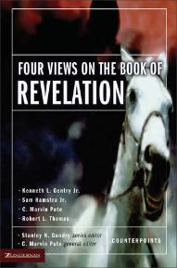
Kenneth Gentry
Four Views of Revelation, p. 38.
“Before beginning my survey, I must note what most Christians suspect and what virtually all evangelical scholars (excluding classic dispensationalists) recognize regarding the book: Revelation is a highly figurative book that we cannot approach with a simple straightforward literalism.”

Slide 17
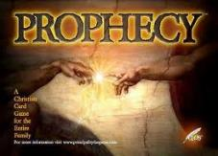
Emergent Eschatology and Genre
“The book of Revelation is an example of popular literary genre of ancient Judaism, known today as Jewish apocalyptic. Trying to read it without understanding its genre would be like watching Star Trek or some other science fiction show thinking it was a historical documentary…instead of being a book about the distant future, it becomes a way of talking about the challenges of the immediate present.”
Brian McLaren, The Secret Message of Jesus, 175-76

Slide 18
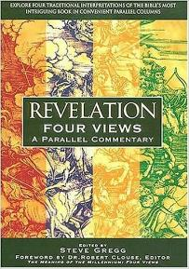
Steve Gregg
Revelation: Four Views, 11
“Another obvious similarity between the Apocalypse and its uninspired counterparts is the use of vivid images and symbols…in depicting the conflict between good and evil. A failure to take in to account this feature has led some to the most outlandish teachings on this book by some whose rule of interpretation is ‘literal unless absurd.’ Though this is a good rule when dealing with literature written in a literal genre, it is the exact opposite in the case of apocalyptic literature, where symbolism is the rule and literalism is the exception.”

Slide 19
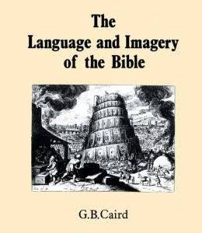
G. B. Caird
The Language and Imagery of the Bible (London: Duckworth, 1980), 253.
J.B. Caird best summarizes the matter when he says, "What seems to have escaped notice at the time is that Eschatology is a metaphor, the application of end of the world language to that which is not literally the end of the world.”

Slide 20
GLOBAL EVENTS YET TO OCCUR
World population destroyed (Rev. 6:8; 9:15)
Sea turns to blood (Rev. 16:3)
Greatest Earthquake in history (Rev. 16:18)
The great city that reigns over the entire earth (Rev. 17:18)

Slide 21
Kenneth Gentry
Four Views of Revelation, p. 38.
“…the preterist view does understand Revelation’s prophecies as strongly reflecting actual historical events in John’s near future, though they are set in apocalyptic drama and clothed in poetic hyperbole.”

Slide 22
Sproul
The Last Days According to Jesus, 45.
“Russell and Calvin agree that the language employed in biblical prophecy is not always cold and logical as is common in the western world, but adopts a kind of fervor common to the East.”

Slide 23
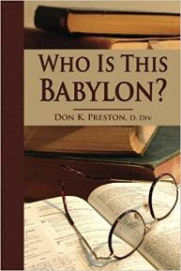
Don Preston
Who Is This Babylon? (Don K. Preston, 1999), 56.
Preterist Don Preston also relies upon Revelation to belonging to the apocalyptic category in order to find support for his view that Revelation's global language was fulfilled in the local events of A.D. 70. He observes that apocalyptic literature hyperbolizes the destruction of Jerusalem. According to Sibylline Oracle 5:153, “the whole creation was shaken” when war began on Jerusalem. If Revelation is also apocalyptic literature, then Revelation must be similarly using hyperbolic language.

Slide 24
Robert Thomas
“A Classical Dispensationalist View of Revelation,” in Four Views of the Book of Revelation, p.181.
“A Preterist approach must assume an apocalyptic genre in which the language only faintly and indirectly reflects the actual events. This extreme allegorical interpretation allows for finding fulfillments in the first-century Roman Empire prior to the destruction of Jerusalem in A.D. 70.”

Slide 25
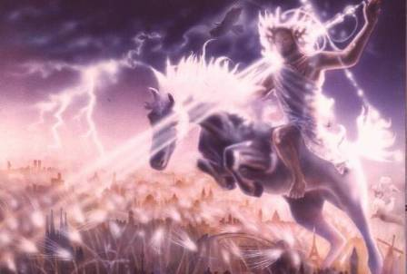
Isaiah 13-14
Day of the Lord (13:6-9)
Cosmic disturbances (13:10-13)
Global judgment (13:11-12)
Sodom and Gomorrah (13:19)
Complete and final desolation (13:20-22)
Universal peace and rest (14:5-8)
Israel’s regeneration (14:1-4)
Morris, Revelation Record, 348.

Slide 26
Isaiah 13/Matthew 24 Connection
Isaiah 13:10; Matthew 24:29
Isaiah 13:12; Matthew 24:21-22

Slide 27
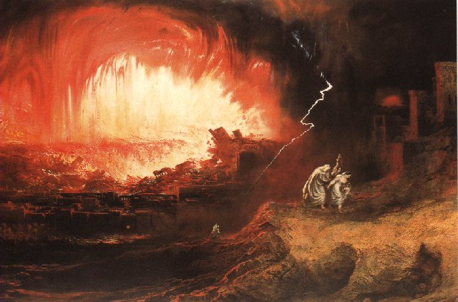
Jeremiah 50-51
Sudden destruction (51:8)
Complete destruction (50:3, 13, 26, 39-40; 51:29, 43, 62)
No reuse of building materials (51:26)
Believers flee (50:8; 51:6, 45)
Israel’s regeneration (50:2, 4-5, 20; 51:50)
Dyer, "The Identity of Babylon in Revelation 17–18 (Part 2)," 443-49.

Slide 28
Herodotus Histories, 1:191 (450 B.C.)
“…he conducted the river by a channel into the lake…and so he made the former course of the river passable by the sinking of the stream. When this had been done, the Persians who had been posted for this very purpose entered by the bed of the river Euphrates into Babylon, the stream having sunk so far that it reached about to the middle of a man’s thigh…those Babylonians who dwelt in the middle did not know that they had been captured…”

Slide 30
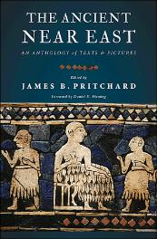
James Pritchard The Ancient Near East Texts Relating to the Old Testament, 315-16.
Without any battle...sparing Babylon...any calamity....I am Cyrus...king of Babylon....When I entered Babylon...under jubilation and rejoicing...troops walked around Babylon...in peace, I did not allow anybody to terrorize (any place) of the [country of Sumer] and Akkad. I strove for peace in Babylon...and in all his (other) sacred cities....I returned to (these) sacred cities on the other side of the Tigris, the sanctuaries of which have been in ruins for a long time, the images which (used) to live therein and established for them permanent sanctuaries.

Slide 31
James Pritchard The Ancient Near East Texts Relating to the Old Testament, 315-16.
I (also) gathered all their (former) inhabitants and returned (to them) their habitations. Furthermore, I resettled...unharmed, in their (former) chapels, the places which make them happy. May all the gods whom I have resettled in their sacred cities ask daily Bel and Nebo for a long life for me...all of them I resettled in a peaceful place... ducks and doves,...I endeavoured to fortify/repair their dwelling places . . .

Slide 32
Isaiah 13-14
Day of the Lord (13:6-9)
Cosmic disturbances (13:10-13)
Global judgment (13:11-12)
Sodom and Gomorrah (13:19)
Complete and final desolation (13:20-22)
Universal peace and rest (14:5-8)
Israel’s regeneration (14:1-4)
Morris, Revelation Record, 348.

Slide 33
Jeremiah 50-51
Sudden destruction (51:8)
Complete destruction (50:3, 13, 26, 39-40; 51:29, 43, 62)
No reuse of building materials (51:26)
Believers flee (50:8; 51:6, 45)
Israel’s regeneration (50:2, 4-5, 20; 51:50)
Dyer, "The Identity of Babylon in Revelation 17–18 (Part 2)," 443-49.

Slide 34
Babylon’s History After 539 B.C.
Herodotus gives Babylon’s measurements (450 B.C.)
Alexander the Great visits and dies in Babylon (323 B.C.)
Seleucus seizes Babylon (312 B.C.)
Strabo pronounces Babylon’s hanging gardens as one of “seven wonders of the world” (25 B.C)
Babylonians present on Pentecost (Acts 2:9)
Talmud promulgated from Babylon (A.D. 500)
Haukal mentions Babylonian village (A.D. 917)
Babylon known as “Two Mosques” and “Hilah” (A.D. 1100)
Hitchcock and Ice, The Truth Behind Left Behind, 109

Slide 35
Dr. John Walvoord The Nations in Prophecy, 63-64
“As far as the historic fulfillment is concerned, it is obvious from both Scripture and history that these verses have not been literally fulfilled. The city of Babylon continued to flourish after the Medes conquered it, and though its glory dwindled, especially after the control of the Medes and the Persians ended in 323 B.C., the city continued in some form or substance until A.D. 1000 and did not experience a sudden termination such as anticipated in this prophecy.”

Slide 36
Parallels Between Jeremiah 50-51 & Revelation 17-18
 | Jeremiah | Revelation
Associated with a Golden cup | 51:7a | 17:3-4; 18:6
Dwelling on many waters | 51:13 | 17:1
Intoxicating the nations | 51:7b | 17:2
Same name | 50:1 | 17:5
Stone sinking into Euphrates | 51:63-64 | 18:21
Sudden destruction | 51:8 | 18:8
Destroyed by fire | 51:30 | 17:16
Final, uninhabitable | 50:39 | 18:21
Deserved | 50:29 | 18:6
God’s people flee | 51:6, 45 | 18:4
Heaven rejoices | 51:48 | 18:20
Dyer, "The Identity of Babylon in Revelation 17–18 (Part 2)," 441-43.

Slide 37
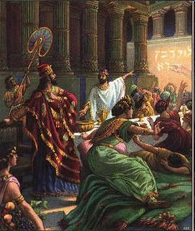
Isaiah’s Oracles Against the Nations (Isa 13–23)
Babylon (13:1-14:23)
Assyria (14:24-27)
Philistia (14:28-32)
Moab (15-16)
Damascus and Samaria (17)
Ethiopia (18)
Egypt (19-20)
Babylon (21:1-10)
Edom (21:11-12)
Arabia (21:13-17)
Jerusalem (22)
Tyre (23)

Slide 38
Isaiah’s Oracles Against the Nations (Isa 13–23)
Babylon (13:1-14:23)
Assyria (14:24-27)
Philistia (14:28-32)
Moab (15-16)
Damascus and Samaria (17)
Ethiopia (18)
Egypt (19-20)
Babylon (21:1-10)
Edom (21:11-12)
Arabia (21:13-17)
Jerusalem (22)
Tyre (23)

Slide 39
Homer Heater
"Do the Prophets Teach That Babylonia Will Rebuilt in the Eschaton?," Journal of the Evangelical Theological Society 41 (March 1998): 31-36; Robert B. Chisholm, Handbook on the Prophets (Grand Rapids: Baker, 2002), 53, 213
A similar approach is seen in Old Testament studies. Many view Isaiah 13-14 and Jeremiah 50-51 as describing Babylon's past fall in 539 B.C. rather than her future fall. The interpretation is held in spite of the fact that the details of these texts go far beyond the historic fall of Babylon. This interpretation is justified on the grounds that Ancient Near Eastern extra biblical writings often describe the destruction of foes in hyperbolic terms. Because Isaiah and Jeremiah incorporated a similar "destruction genre" in their description of Babylon's fall, the language of Babylon's destruction in Isaiah 13-14 and Jeremiah 50-51 can be applied to her historic fall rather than her future fall. Chisholm calls such language “stylized and exaggerated” and therefore argues that these texts were “essentially fulfilled” with the historic defeat of Babylon.

Slide 40
B. Hermeneutical Doors
Impossibility of literalism
Apocalyptic multivalence
Code theories
Numbers as concepts and not count units

Slide 41
John Collins
The Apocalyptic Imagination: An Introduction to Jewish Apocalyptic Literature, 51.
“In other Jewish apocalypses the Babylonian crisis of the sixth century often provides the filter through which later crises are viewed. The emphasis is not on the uniqueness of the historical events but on recurring patterns, which assimilate the particular crisis to some event of the past whether historical or mythical.”

Slide 42
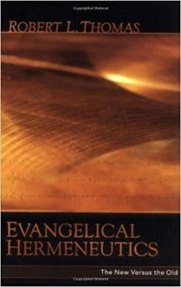
Robert Thomas
“Evangelical Hermeneutics,” .362.
“Blaising and Bock…interpret Babylon in Revelation 17‒18 as representing Rome and Rebuilt Babylon on the Euphrates, and in addition, in ‘the sweep of history’ it could represent any city since the world empire’s center is always shifting.”

Slide 43
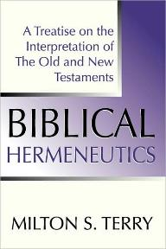
Milton Terry
Biblical Hermeneutics: A Treatise on the Interpretation of the Old and New Testaments (1885; reprint, Grand Rapids: Zondervan, 1947), 205.
Milton Terry explains: “A fundamental principle in grammatico-historical exposition is that the words and sentences can have but one significance in one and the same connection. The moment we neglect this principle we drift upon a sea of uncertainty and conjecture.”

Slide 44
B. Hermeneutical Doors
Impossibility of literalism
Apocalyptic multivalence
Code theories
Numbers as concepts and not count units

Slide 45
“MYSTERY” IN HARLOT’S TITLE? REV. 17:5
And on her forehead a name was written: MYSTERY, BABYLON THE GREAT, THE MOTHER OF HARLOTS AND OF THE ABOMINATIONS OF THE EARTH. (KJV, NIV)
… and upon her forehead a name was written, a mystery, “BABYLON THE GREAT, THE MOTHER OF HARLOTS AND OF THE ABOMINATIONS OF THE EARTH.” (NASB)

Slide 46
Literal Geography in Revelation Thomas, Revelation 8 to 22: An Exegetical Commentary, 206-207.
Asia | 1:4 | Sardis | 3:1
Ephesus | 2:1 | Philadelphia | 3:7
Smyrna | 2:8 | Laodicea | 3:14
Pergamum | 2:12 | Euphrates | 9:14;16:12
Thyatira | 2:18 | Armageddon | 16:16

Slide 47
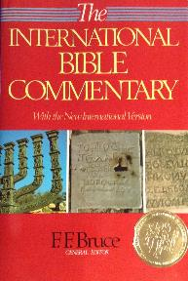
F. F. Bruce “Revelation,” in International Bible Commentary, 1986, p. 1621.
“This title was written on her forehead: Mystery: ‘mystery’ indicates that the name she bears...is not to be understood literally, but allegorically: Babylon the Great is read, but ‘Rome’ is meant (cf. verses 9, 19).”

Slide 48
Robert Thomas
“Evangelical Hermeneutics,” .336.
“Another clear distinctive of literal interpretation is its avoidance of assumptions not justified in the text. Theories that 'Babylon' in Revelation chapters 14 and 16-18 is a code for Rome have been widespread.”

Slide 49
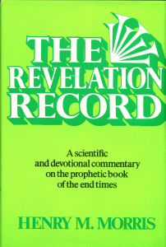
Morris
The Revelation Record, 323
“At the very least, it would be confusing to John’s first century readers, as well as to later generations, for him to write so much about Babylon when he really meant Rome (Paul was not afraid to speak directly against Rome in his writings, so why should John be?) or ‘the false church’ (all the apostles , including John, wrote plainly and scathingly about false teachers and false doctrines in the church and would not hide their teachings by symbols). It must be stressed that Revelation means “unveiling,” not “veiling.” In the absence of any statement in the text to the contrary, therefore, we must assume that the term Babylon applies to the real city of Babylon…”

Slide 50
B. Hermeneutical Doors
Impossibility of literalism
Apocalyptic multivalence
Code theories
Numbers as concepts and not count units

Slide 51
Steve Gregg
Revelation: Four Views, 11-12
“As in other apocalypses, certain numbers in Revelation convey concepts more than count units. The most evident of these is seven ‒ the number of completeness or perfection.”

Slide 52
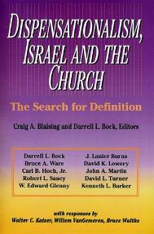
David L. Turner
“The New Jerusalem in Revelation 21:1-22:5; Consummation of a Biblical Continuum,” Dispensationalism, Israel, and the Church, ed., Craig A. Blaising and Darrell L. Bock (Grand Rapids: Zondervan, 1992), 277.
“Perhaps the absence of oysters large enough to produce such pearls in the absence of sufficient gold to pave such as city (do you just literally 1380 miles squared and high) is viewed as sufficient reason not to take these images as fully literal!… The preceding discussion serves to warn against a ‘hyper-literal’ approach to apocalyptic imagery….”

Slide 53
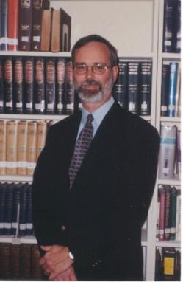
Kenneth L.Gentry
He Shall Have Dominion: A Post Millennial Eschatology (Tyler, Texas: Institute for Christian economics, 1992), page 335.
“The proper understanding of the thousand-year time frame in Revelation 20 is that it is representative of a long and glorious era and is not limited to a literal 365,000 days. The figure represents a perfect cube of 10, which is the number of quantitative perfection.”

Slide 54
Reasons for Understanding 1000 Literally
John’s use of indefinite concepts elsewhere
Revelation 20:8, 20:3
Exception to the “# of years” examples?
Other numbers are taken literally
Two witnesses (11:3), 7000 people (11:13), 4 Angels (7:1) 7 Angels (8:6),144,000 Jews (7:4), 42 months (11:2), 1260 days (11:3)
Not always a symbolic interpretation
(Rev. 17:18)

Slide 55
Robert Thomas
Revelation 8 to 22: An Exegetical Commentary (Chicago: Moody Press, 1992), 408.
Robert Thomas observes that, "no number in Revelation is verifiably a symbolic number.”

Slide 56
Apocalyptic Genre and Inerrancy
The New Approach
Apocalyptic Classification
Hermeneutical Doors
Weaknesses
The Traditional Approach
Prophecy Classification
Consistent literalism
Symbolic Language?

Slide 57
Charles L. Feinberg
Millennialism: The Two Major Views (Winona Lake, IN: BMH, 1985), 27-28.
“...this study is to be based for its source material on the Bible alone and not upon secular or apocryphal literature. Why the necessity for such an explanation? The answer is to be found in the number of books that attempt to trace the roots of the millennial doctrine in some perverted works extraneous to the Bible. One writer was found who concluded such a discussion with the honest admission that the study of such sources yielded nothing to a biblical study of the question of the millennium. So we intend to center our attention upon the Word of God as our first and last authority, which is as it should be with all doctrines held by those who adhere to the orthodox position on the Bible.”

Slide 58
Apocalyptic Genre Versus Revelation Adapted from Thomas, Evangelical Hermeneutics, 338
APOCALYPTIC GENRE | REVELATION
Pseudonymous | Not pseudonymous
Pessimistic about the present | Not pessimistic about the present
No epistolary framework | Epistolary framework
Limited admonitions for moral compliance | Repeated admonitions for moral compliance
Messiah’s coming exclusively future | Basis for Messiah’s coming is past
Does not call itself prophecy | Calls itself prophecy
Vaticina ex eventu | Futuristic prediction
Primarily concerns a future generation (1 Enoch 1:2) | Concerns both the present generation of the author (Rev 2–3) and a future generation (Rev 4–22)

Slide 59
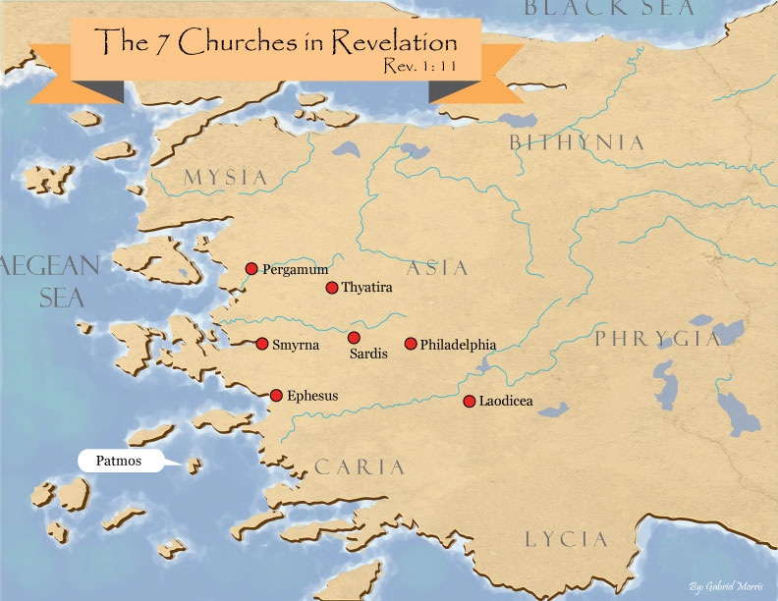

Slide 60
Apocalyptic Genre Versus Revelation Adapted from Thomas, Evangelical Hermeneutics, 338
APOCALYPTIC GENRE | REVELATION
Pseudonymous | Not pseudonymous
Pessimistic about the present | Not pessimistic about the present
No epistolary framework | Epistolary framework
Limited admonitions for moral compliance | Repeated admonitions for moral compliance
Messiah’s coming exclusively future | Basis for Messiah’s coming is past
Does not call itself prophecy | Calls itself prophecy
Vaticina ex eventu | Futuristic prediction
Primarily concerns a future generation (1 Enoch 1:2) | Concerns both the present generation of the author (Rev 2–3) and a future generation (Rev 4–22)

Slide 61
Apocalyptic Genre and Inerrancy
The New Approach
Apocalyptic Classification
Hermeneutical Doors
Weaknesses
The Traditional Approach
Prophecy Classification
Consistent literalism
Symbolic Language?

Slide 62
Apocalyptic Genre and Inerrancy
The New Approach
Apocalyptic Classification
Hermeneutical Doors
Weaknesses
The Traditional Approach
Prophecy Classification
Consistent literalism
Symbolic Language?

Slide 63
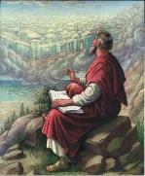
Revelation 1:3
“Blessed is he who reads and those who hear the words of the prophecy, and heed the things which are written in it; for the time is near.”

Slide 64
OT Prophets Comfort Through Futuristic Visions
Isaiah 40–66
Ezekiel 34–48
Amos 9:11-15
Zechariah 12–14
Revelation 4–22

Slide 66
Matthew 24:15
“Therefore when you see the abomination of desolation which was spoken of through Daniel the prophet, standing in the holy place (let the reader understand).”

Slide 67
Revelation 1:1
“The Revelation [apokalypsis] of Jesus Christ, which God gave Him to show to His bond-servants, the things which must soon take place; and He sent and communicated it by His angel to His bond-servant John.”

Slide 68
Morris
The Revelation Record, 323
“At the very least, it would be confusing to John’s first century readers, as well as to later generations, for him to write so much about Babylon when he really meant Rome (Paul was not afraid to speak directly against Rome in his writings, so why should John be?) or ‘the false church’ (all the apostles , including John, wrote plainly and scathingly about false teachers and false doctrines in the church and would not hide their teachings by symbols). It must be stressed that Revelation means “unveiling,” not “veiling.” In the absence of any statement in the text to the contrary, therefore, we must assume that the term Babylon applies to the real city of Babylon…”

Slide 69
Apocalyptic Genre and Inerrancy
The New Approach
Apocalyptic Classification
Hermeneutical Doors
Weaknesses
The Traditional Approach
Prophecy Classification
Consistent literalism
Symbolic Language?

Slide 70
Robert L. Thomas
Revelation 1 to 7: An Exegetical Commentary (Chicago: Moody Press, 1992), 38.
“Because in broad perspective the Apocalypse is prophetic in nature as is the rest of the NT, therefore, a different set of hermeneutical principles is not needed to interpret it.”

Slide 71
GLOBAL EVENTS YET TO OCCUR
World population destroyed (Rev. 6:8; 9:15)
Sea turns to blood (Rev. 16:3)
Greatest Earthquake in history (Rev. 16:18)
The great city that reigns over the entire earth (Rev. 17:18)

Slide 72
Apocalyptic Genre and Inerrancy
The New Approach
Apocalyptic Classification
Hermeneutical Doors
Weaknesses
The Traditional Approach
Prophecy Classification
Consistent literalism
Symbolic Language?

Slide 74
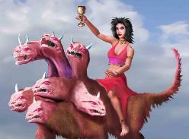
Revelation's Symbols and Figures of Speech
“Spiritually” (11:8)
“Sign” (12:1)
“Like” or “as” (8:8)
OT correspondence (Rev 13:2; Dan 7)
Contextual interpretations (17:18)
Absurdity (12:1)

Slide 75
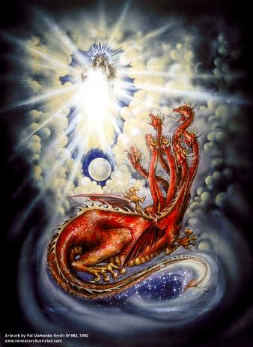
Assigning Meaning to Revelation’s Symbols and Figures of Speech
Context (Rev 12:3, 9)
Old Testament (Rev 12:1; Gen 37:9-10)
Comparison (Rev 8:8)

Slide 76
Two Rules of Interpretation
Search the immediate context
Walvoord: 26X
Search the remote context
Old Testament
Thomas: 278 / 404 verses

Slide 77
Genesis 37:9
Now he had still another dream, and related it to his brothers, and said, “Lo, I have had still another dream; and behold, the sun and the moon and eleven stars were bowing down to me.

Slide 78
Genesis 37:10
He related it to his father and to his brothers; and his father rebuked him and said to him, “What is this dream that you have had? Shall I and your mother and your brothers actually come to bow ourselves down before you to the ground?”

Slide 79
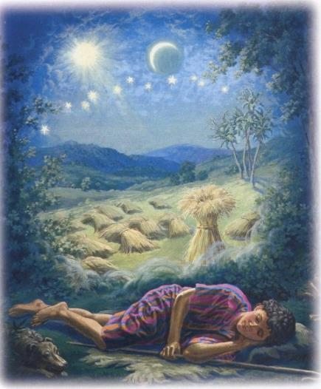
Assigning Meaning to Revelation’s Symbols and Figures of Speech
Sun = Jacob
Moon = Leah
11 Stars=Joseph’s bothers
12th Star = Joseph
12 Stars=Israel’s twelve tribes

Slide 80
Conclusion

Slide 81
Apocalyptic Genre and Inerrancy
The New Approach
Apocalyptic Classification
Hermeneutical Doors
Weaknesses
The Traditional Approach
Prophecy Classification
Consistent literalism
Symbolic Language?

Slide 82
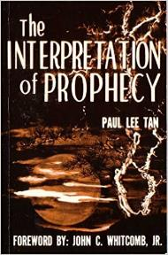
Paul Lee Tan
The Interpretation of Prophecy, 276-77
“Evangelicals who spiritualize Bible prophecy cannot logically forbid liberals and modernists from spiritualizing selected areas of Christology and Soteriology. If evangelicals can spiritualize Christ's earthly kingdom, may not liberals spiritualize the earthly ministry of Christ, including His miracles and resurrection? The same hermeneutical principles used to spiritualized Bible prophecy can be used to spiritualize Christ's first advent. Christians who spiritualize parts of the Scriptures, such as it's prophetic portions, have forfeited a major element of their defense against liberalism.”

