Slide 1
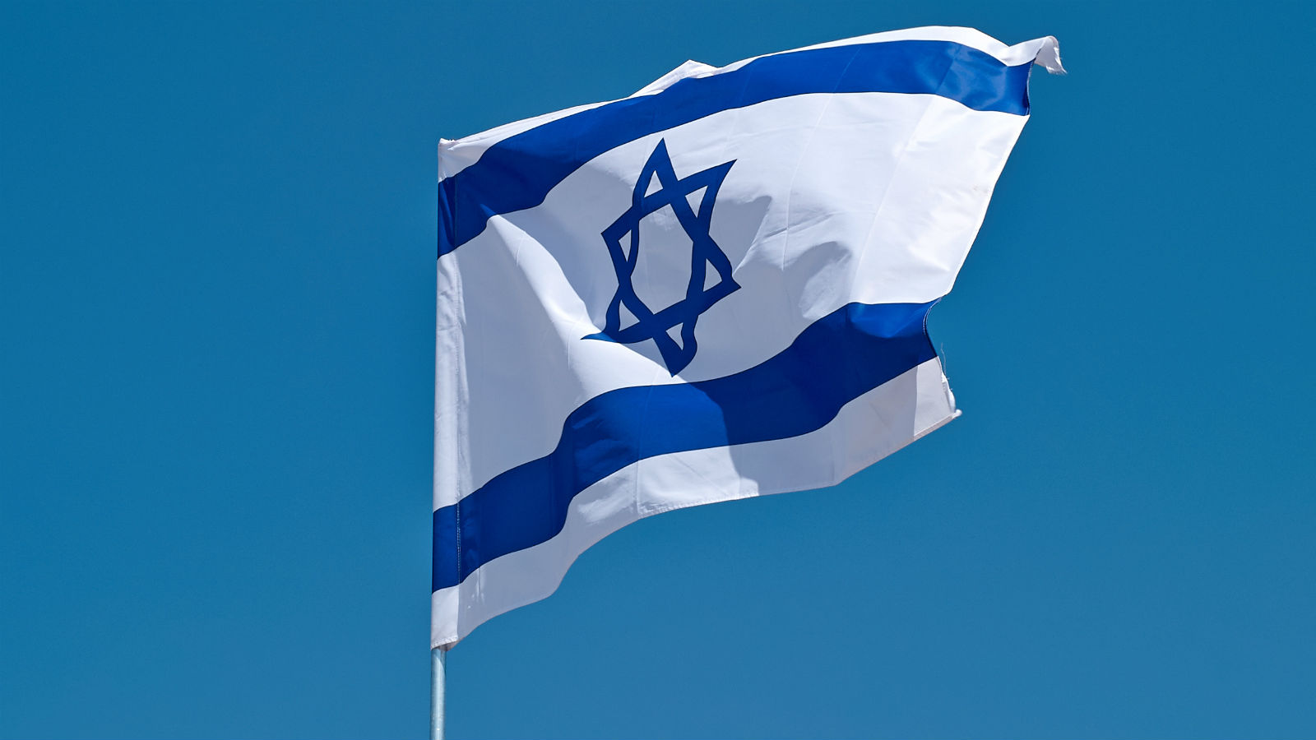
Israel
in the…
…Book of Revelation
Dr. Mike Stallard
Friends of Israel

Slide 2
Jewish Imagery from Old Testament Israel
Jesus’s description in Revelation chapter one correlates to the Ancient of Days in Daniel 7

Slide 3
Jewish Imagery from Old Testament Israel
Jesus’s description in Revelation chapter one correlates to the Ancient of Days in Daniel 7
Lampstands in chapter one relate to churches

Slide 4
Jewish Imagery from Old Testament Israel
Jesus’s description in Revelation chapter one correlates to the Ancient of Days in Daniel 7
Lampstands in chapter one relate to churches
Imagery from Zechariah 4 helps understand the “seven spirits” of Rev. 1:4, 5:6, etc.

Slide 5
Jewish Imagery from Old Testament Israel
Jesus’s description in Revelation chapter one correlates to the Ancient of Days in Daniel 7
Lampstands in chapter one relate to churches
Imagery from Zechariah 4 helps understand the “seven spirits” of Rev. 1:4, 5:6, etc.
Revelation chapters 2 & 3 make reference to Jews and synagogues
2:9 …those who say they are Jews and are not (see also 2:14)
3:9 ..those of the synagogue of Satan, who say they are Jews and are not…
3:12 mention of temple and the New Jerusalem

Slide 6
Israel’s First Appearance
144,000
Chapter 7
The Two Witnesses
Chapter 11
Dragon Against Israel
Chapter 12
Glimpse of
Kingdom
Chapter 14
The New
Jerusalem
Chapter 21
Israel’s Future in Revelation: Ministry, Persecution, and Glory

Slide 7
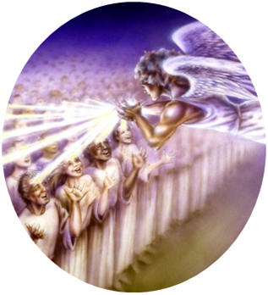
The 144,000 in Rev. 7
Introduction
Tribulation Period is in view
The sealing of God’s servants (7:1-3)

Slide 8
Questions
Who is sealed?
144,000 from all the tribes of Israel (7:4)
12,000 from each tribe (7:5-8)
Tribes are listed specifically (7:5-8)
Is the reference to Israel literal?

Slide 9
Questions
Is the number 12,000 literal? Is the number 144,000 literal?
Some see the number as representing completeness
Some see the number representing government
Most numbers in Revelation appear to be literal
The detail of the passage points to a literal interpretation

Slide 10
3. What is the purpose of the sealing of the 144,000?

Slide 11
Questions
What is the purpose of the sealing of the 144,000?
The text clearly says it is for protection – “Do not harm the earth, the sea, or the trees till we have sealed the servants of our God on their foreheads” (7:3)
The protection may be until the ministry of the 144,000 is complete
In light of Rev 14, they may be protected for the entire tribulation period

Slide 12
Contrast to the Mark of the Beast in Rev. 13

Slide 13
Questions
Why is the tribe of Dan missing in the list of tribes?
No one really knows
Some believe it is because Antichrist comes from the tribe of Dan
Dan is called a serpent in Gen. 49:17
The location of Dan in northeast Israel helps bolster the tradition that the Antichrist will be a Syrian Jew
However, there is no clear line of evidence that leads to the conclusion. We will have to wait and see!

Slide 14
Questions
What is the mission of the 144,000?
According to Rev. 14:4, the 144,000 serve the Lamb of God
There is evidence that the 144,000 are witnesses for Christ

Slide 15
Evidence that the 144,000 are Witnesses
To serve Christ involves sharing faith when necessary
The 144,000 in Rev. 7:1-8 precedes the section in Rev. 7: 9-17 about martyrs during the tribulation who receive salvation

Slide 16
Evidence that the 144,000 are Witnesses
The 144,000 may anticipate the special Two Witnesses of chapter 11
God engages Israel again in the tribulation period and that nation was always to be a light to the world (e.g., Isaiah 60:1-3)

Slide 17
THE TWO WITNESSES Revelation 11:1-14

Slide 18
QUESTIONS
Who are the Two Witnesses in general?
They are two Jewish men
Notice the Jewish indicators in the passage
The Jewish temple (11:1-2)
The holy city Jerusalem (11:2, 8, 13)
The witnesses are called olive trees (11:4)
The witnesses are called lampstands (11:4)

Slide 19
QUESTIONS
What is the mission of the Two Witnesses?
To prophesy for 1260 days (Jewish years average 360 days so this is 3 ½ years or 42 months) – See 11:2-3
To witness and give testimony about God and his plan (11:3, 7)
To exercise supernatural powers as needed (11:5-6)

Slide 20
3. What is the identity of the Two Witnesses?
Enoch
and
Elijah
Moses and
Elijah
(11:6; Mal. 4:5-6)
Two prophets like Moses and Elijah

Slide 21
3. What is the identity of the Two Witnesses?
Enoch
and
Elijah
Moses and
Elijah
(11:6; Mal. 4:5-6)
Two prophets like Moses and Elijah

Slide 22
4. What is the destiny of the Two Witnesses?
Earthly murder and
death
(11:7-10)
Physical resurrection and ascension to heaven
(11:11-12)

Slide 23
The
Dragon
Against
Israel
In
Revelation 12

Slide 24
Revelation 12
The woman (Gen. 37:9)
The child
The dragon

Slide 25
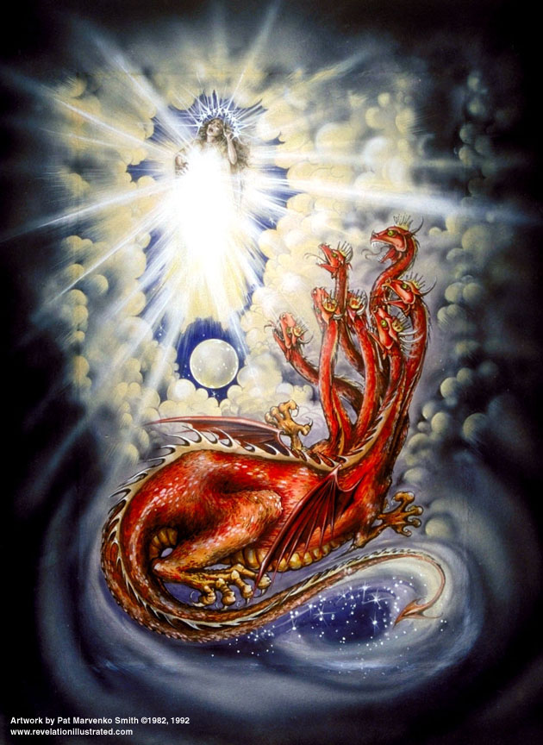
Identification of the Child
This is clear and easy
Chapter 12, Verse 5
“And she gave birth to a son, a male child, who is to rule all the nations with a rod of iron; and her child was caught up to God and to his throne.

Slide 26
Identification of the Red Dragon
This is clear and easy
Chapter 12, Verse 9
“And the great dragon was thrown down, that ancient serpent, who is called the devil and Satan, the deceiver of the whole world…”

Slide 27
Identification of the Woman
Three Views
The Virgin Mary (Catholic View)
Reason to reject:
The text says that the woman is a sign which means she is symbolic not a real woman (v. 1).

Slide 28
Identification of the Woman
Three Views
The Church
Reason to reject:
If this is correct, it means the Church gave birth to Christ. But this is backwards. Christ gave birth to the Church (Acts 2).

Slide 29
Identification of the Woman
Three Views
Israel
Reasons to accept:
Image defined in Genesis 37:9-11
The image refers to the family of Jacob or Israel
Context of Rev 12 makes sense if there is a future for Israel

Slide 30
Glimpse of Kingdom in Rev. 14

Slide 31
The 144,000 on Mount Zion Revelation 14:1-5
The location is Mount Zion = Jerusalem on earth (v. 1)
Voices from heaven are heard on earth (v. 2)

Slide 32
The 144,000 on Mount Zion Revelation 14:1-5
The 144,000 are being taught a new song of redemption (v. 3)
Further descriptions of the 144,000 (v. 4-5)
This is a glimpse of the coming kingdom

Slide 33
The
New
Jerusalem
Rev. 21

Slide 34
The Gates of the City (Rev. 21:12)
“It had a great and high wall, with twelve gates, and at the gates twelve angels; and names were written on them, which are those of the twelve tribes of the sons of Israel.”

Slide 35
Do ethnic Jews and the nation of Israel have a place in God’s future plans for the world?
YES!

Slide 36
Israel’s First Appearance
144,000
Chapter 7
The Two Witnesses
Chapter 11
Dragon Against Israel
Chapter 12
Glimpse of
Kingdom
Chapter 14
The New
Jerusalem
Chapter 21
Israel’s Future in Revelation: Ministry, Persecution, and Glory

Slide 37
The Future
of Israel
in the…
…Book of Revelation
Dr. Mike Stallard
Friends of Israel

