Slide 1
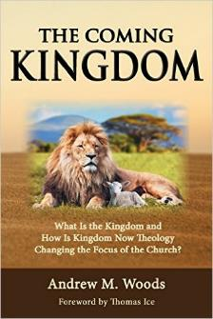

The Negative Impact of Kingdom Now Theology on a Dispensational Worldview
Council on Dispensational Hermeneutics Conference 9-15-21
Dr. Andy Woods
Senior Pastor – Sugar Land Bible Church
President – Chafer Theological Seminary

Slide 2

Dominoes in a Row

Slide 3


Areas of Systematic Theology
Prolegomena – Introduction
Theology – Study of God
Christology – Study of Christ
Pneumatology – Study of the Holy Spirit
Anthropology – Study of Man
Hamartiology – Study of sin
Soteriology – Study of salvation
Angelology – Study of angels
Ecclesiology – Study of the Church
Eschatology – Study of the end

Slide 4
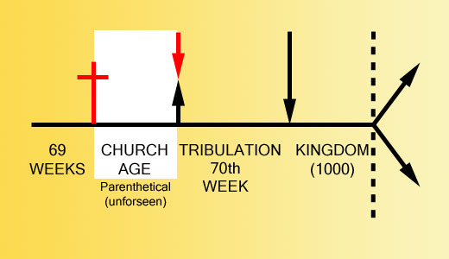

Slide 5

Dr. Robert Lightner
Purposes of the Local Church
Glorify God (Eph 3:21)
Edify the saints (Eph 4:11-16)
Fulfill the Great Commission (Matt 28:18-20)

Slide 6

Alva J. McClain
Alva J. McClain, The Greatness of the Kingdom: An Inductive Study of the Kingdom of God as Set Forth in the Scriptures (Grand Rapids: Zondervan, 1959), 438-39.
“Theological confusion, especially in matters which have to do with the church, will inevitably produce consequences which are of grave practical concern. The identification of the Kingdom with the church has led historically to ecclesiastical policies and programs which, even when not positively evil, have been far removed from the original simplicity of the New Testament ekklēssia. It is easy to claim that in the ‘present kingdom of grace’ that the rule of the saints is wholly ‘spiritual,’ exerted only through moral principles and influence. But practically, once the church becomes the Kingdom in any realistic theological sense, it is impossible to draw any clear line between principles and their implementation through political and social devices. For the logical implications of a present ecclesiastical kingdom are unmistakable, and historically have always led in one direction, i.e., political control of the state by the church.”

Slide 7

8 Ways Kingdom Now Theology Impacts the Church
Loss of “pilgrim” status
Social Gospel
Ecumenical & interfaith alliances
Rejection or marginalization of Bible prophecy
Building the wrong kingdom
Charismatic theology
Prosperity Gospel
Anti-Israelism

Slide 8
8 Ways Kingdom Now Theology Impacts the Church
Loss of “pilgrim” status
Social Gospel
Ecumenical & interfaith alliances
Rejection or marginalization of Bible prophecy
Building the wrong kingdom
Charismatic theology
Prosperity Gospel
Anti-Israelism

Slide 9
Alva J. McClain
Alva J. McClain, The Greatness of the Kingdom: An Inductive Study of the Kingdom of God as Set Forth in the Scriptures (Grand Rapids: Zondervan, 1959), 438-39.
“The distances traveled down this road by various religious movements, and the forms of control which were developed, have been widely different. The difference is very great between the Roman Catholic system and modern Protestant efforts to control the state; also between the ecclesiastical rule of Calvin in Geneva and the fanaticism of Münster and the English ‘fifth-monarchy.’ But the basic assumption is always the same: The church in some sense is the kingdom, and therefore has a divine right to rule; or it is the business of the church to ‘establish’ fully the Kingdom of God among men. Thus the church loses its pilgrim character and the sharp edge of its divinely commissioned ‘witness’ is blunted. It becomes an ekklēssia which is not only in the world, but also of the world. It forgets that just as in the regeneration of the soul only God can effect the miracle, even so the ‘regeneration’ of the world can only be wrought by the intrusion of regal power from on high (Matt. 19:28).”

Slide 10

Lewis Sperry Chafer
vol. 5, Systematic Theology (Grand Rapids, MI: Kregel Publications, 1993), 350.
“So the church was fully warned from the beginning about the nature of this age, and taught concerning her pilgrim character while here and her holy calling and separateness from the ‘evil age.’”

Slide 11
8 Ways Kingdom Now Theology Impacts the Church
Loss of “pilgrim” status
Social Gospel
Ecumenical & interfaith alliances
Rejection or marginalization of Bible prophecy
Building the wrong kingdom
Charismatic theology
Prosperity Gospel
Anti-Israelism

Slide 12
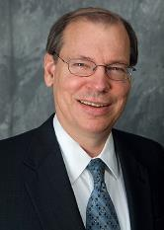
Progressive Dispensationalism & Social Gospel
Craig Blaising, “Dispensationalism: The Search for Definition,” in Dispensationalism, Israel and the Church, ed. Craig Blaising and Darrell Bock (Grand Rapids: Zondervan, 1992), 14, n. 3; Craig Blaising, “Theological and Ministerial Issues in Progressive Dispensationalism,” in Progressive Dispensationalism, ed. Darrell Bock and Craig Blaising(Wheaton, IL: Victor, 1993), 288–89.
“Unfortunately, present-day dispensationalists have written very little in proposing a theology of social ministry…if we as a community of Christ worked on creating our community as a model of social justice and peace, then we really would have some suggestions to make for social reform in our cities and nations.”
Notes:
WRONG!!!

Slide 13

Charles Ryrie
Dispensationalism, Page 176
“Holistic redemption can easily lead to placing unbalanced, if not wrong, priorities on political action, social agendas, and improving the structures of society.”

Slide 14
Emergent Church & the Kingdom
Brian McLaren, cited in Oakland, Faith Undone, 158.
“If Revelation were a blueprint of the distant future, it would have been unintelligible to its original readers…In light of this, Revelation becomes a powerful book about the kingdom of God here and now, available to all.”

Slide 15
Emergent Church & the Kingdom
Brian McLaren, cited in Oakland, Faith Undone, 203.
“The church has been preoccupied with the question, ‘What happens to your soul after you die?’ As if the reason for Jesus coming can be summed up in, ‘Jesus is trying to get more souls into heaven as opposed to hell, after they die.’ I just think a fair reading of the Gospels blows that out of the water.”

Slide 16
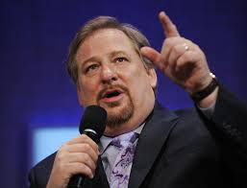
Kingdom
“I stand before you confidently right now and say to you that God is going to use you to change the world...I'm looking at a stadium full of people right now who are telling God they will do whatever it takes to establish God's Kingdom ‘on earth as it is in heaven.’ What will happen if the followers of Jesus say to Him, "We are yours?" What kind of spiritual awakening will occur?”
Rick Warren, cited in Oakland, Faith Undone, Kindle edition.

Slide 17
Kingdom
“P.E.A.C.E. is an acronym for Promote reconciliation; Equip servant leaders; Assist the poor; Care for the sick; and Educate the next generation. Coalition members see these actions as Jesus’ antidote to five ‘global giants,’—problems that affect billions of people worldwide: spiritual emptiness, self-centered leadership, poverty, pandemic disease, and illiteracy.”
Rick Warren and 1,700 Leaders Launch the Peace Coalition at “Purpose Driven Summit,” accessed November 15, 2014

Slide 18

The Great Omission?
Matthew 28:19
Mark 16:15
Luke 24:46-49
John 20:21
Acts 1:4-8

Slide 19
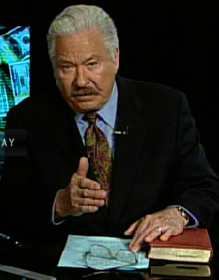
Hal Lindsey
The Road to Holocaust, 269
Bestselling author Hal Lindsey warned what could happen to the church in the last days if she began to see herself as the establisher of God's kingdom: “The last days of the church on the earth may be largely wasted seeking to accomplish a task that only the LORD Himself can and will do directly.”

Slide 20
8 Ways Kingdom Now Theology Impacts the Church
Loss of “pilgrim” status
Social Gospel
Ecumenical & interfaith alliances
Rejection or marginalization of Bible prophecy
Building the wrong kingdom
Charismatic theology
Prosperity Gospel
Anti-Israelism

Slide 21
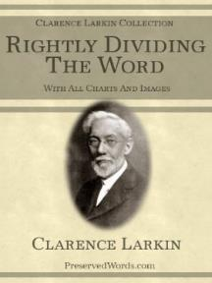
Clarence Larkin
Rightly Dividing the Word, 48.
“The great mistake the Church has made is in appropriating to herself in this Dispensation the promises of earthly conquest and glory which belong exclusively to Israel in the ‘Millennial Age.’ As soon as the Church enters into an ‘Alliance with the World,’ and seeks the help of Parliaments, Congresses, Legislatures, Federations and Reform Societies, largely made up of ungodly men and women, she loses her spiritual power and becomes helpless as a redeeming force.”

Slide 22

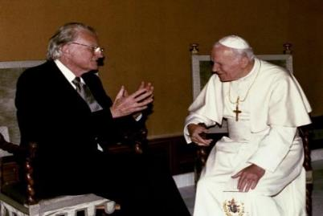
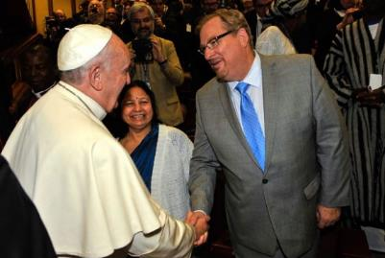
Evangelicals and Catholics Together

Slide 23
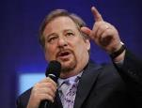
Ecumenisim
Matt Slick, “Rick Warren’s Comments on Roman Catholicism,” accessed July 20, 2015, http://www.carm.org.
“But the most important thing is if you love Jesus, we’re on the same team. The unity that I think we would see realistically is not a structural unity but a unity of mission. And so, when it comes to the family we are co-workers in the field on this for the protection of what we call the sanctity of life, the sanctity of sex, and the sanctity of marriage. So there’s a great commonality and there’s no division on any of those three. Many times people have been beaten down for taking a biblical stance. And they start to feel, “Well, maybe I’m out here all by yourself.” No, you’re not (italics added)”

Slide 24
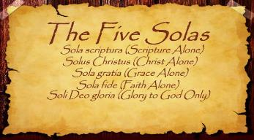
The Five Solas (Alone or By Itself)
Solus Christus-Christ alone
Sola Fide-faith alone
Sola Gratia-grace alone
Sola Scriptura-Scripture alone
Soli Deo Gloria-To the glory of God alone

Slide 25

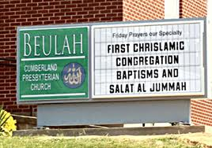

Slide 26
Ecumenisim
http://m.youtube.com/watch?v=nu7_rtUQiE0
“To my Islamic brother here from Italy, I would say I’m not really interested in inter-faith dialogue; I’m interested in inter-faith projects. We’ve got enough talk. So . . . a few weeks ago, at Georgetown University, we brought in three imams, we brought in three Catholic priests, we brought in three evangelical pastors, and we brought in three Rabbis and we said, ‘What can we do about AIDS?’ And we started on some common ground on those issues; what can we do that we all care about?”

Slide 27
Ecumenisim
https://www.youtube.com/watch?feature=player_detailpage&v=tJeNsPIC3vE
“I humbly ask this in the name of the one who changed my life, Yeshua, Isa, Jesus [Spanish pronunciation], Jesus, who taught us to pray.”

Slide 28
Ecumenisim
Eric Barger, “Rick Warren Invokes the Name of Islamic Jesus at Obama Inauguration” (January 2009), accessed January 4, 2015, http://www.ericbarger.com /emailers/2009/update1-21-2009.htm.
“‘Isa’ in no way represents the Jesus of the Bible but is instead the false Jesus of the Qur’an (Koran) and the Muslim Hadith. ‘Isa’ (pronounced ‘eee-sa’) is the Islamic Jesus who was but a prophet and who certainly did not experience a sacrificial death on a cross let alone resurrect from the dead. In fact, in Islam the prophet Isa is actually the destroyer of Christianity—not it’s Savior. Obviously, this is simply NOT the same Jesus as is Yeshua.”

Slide 29
8 Ways Kingdom Now Theology Impacts the Church
Loss of “pilgrim” status
Social Gospel
Ecumenical & interfaith alliances
Rejection or marginalization of Bible prophecy
Building the wrong kingdom
Charismatic theology
Prosperity Gospel
Anti-Israelism

Slide 30
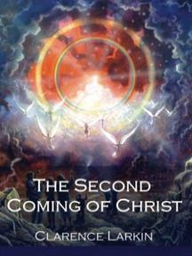
Clarence Larkin
The Second Coming of Christ, 51.
“The ‘Kingdom Idea’ has robbed the Church of her ‘UPWARD LOOK,’ and of the ‘BLESSED HOPE.’ There cannot be any ‘Imminent Coming’ to those who are seeking to ‘Set up the Kingdom.’”

Slide 31
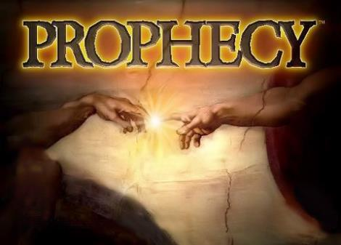
Biblical Prophecy: Importance
27% of Scripture was prophetic at the time it was written
2 Pet 1:19

Slide 32
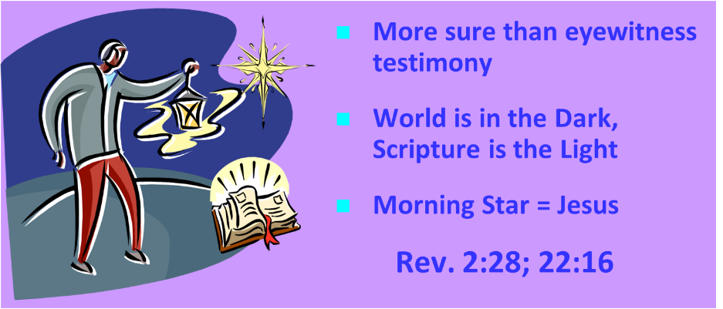
PROPHECY & THE AUTHORITY OF SCRIPTURE
2 Peter 1:19

Slide 33
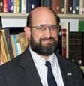
Ante-Nicene Fathers: “Heavenly and Eschatological" Interpretation of John 14:1-4
“Interestingly, references to John 14:1-3 virtually disappear when perusing the writings of the Nicene and Post-Nicene fathers. This is a bit surprising, given the abundance of material in these later writers when compared with the Ante-Nicenes. I would assume that with the rise of Augustinian amillennialism and its optimistic interpretation regarding the present arrival of the Kingdom of God, the kind of hope held out in John 14:1-3 ceased to hold relevance.”
George A. Gunn, “Jesus and the Rapture: John 14,” in Evidence for the Rapture: A Biblical Case for Pretribulationism, ed. John F. Hart (Chicago: Moody, 2015), 119, n. 22.

Slide 34
Rick Warren
Purpose Driven Life, 285-86.
“When the disciples wanted to talk about prophecy, Jesus quickly switched the conversation to evangelism. He wanted them to concentrate on their mission in the world. He said in essence, ‘The details of my return are none of your business. What is your business is the mission I have given you. Focus on that!’ If you want Jesus to come back sooner, focus on fulfilling your mission, not figuring out prophecy. Speculating on the exact timing of Christ’s return is futile, because Jesus said, ‘No one knows about that day or hour, not even the angels in heaven, nor the Son, but only the Father.’ Since Jesus said He didn’t know the day or hour, why should you try to figure it out? What we do know for sure is this: Jesus will not return until everyone God wants to hear the Good News has heard it.”

Slide 35
Rick Warren
Purpose Driven Life, 285-86.
“Jesus said, ‘The Good News about God’s kingdom will be preached in all the world, to every nation. Then the end will come.’ If you want Jesus to come back sooner, focus on fulfilling your mission, not figuring out prophecy. It is easy to get distracted and sidetracked from your mission because Satan would rather have you do anything besides sharing your faith. He will let you do all kinds of good things as long as you don’t take anyone to heaven with you. But the moment you become serious about your mission, expect the Devil to throw all kinds of diversions at you. When that happens, remember the words of Jesus: ‘Anyone who lets himself be distracted from the work I plan for him is not fit for the Kingdom of God.’”

Slide 36
Charles Ryrie
Dispensationalism, Page 176-177
“…ignoring the great prophecy of the seventy weeks in Daniel 9:24–27. Nowhere in the progressives’ writings to date have I found any discussion of the passage, only very brief and occasional citations of the reference itself. . . . While not denying the pre-tribulation Rapture or the literal tribulation period, revisionists do not give much attention to these aspects of eschatology. Blaising and Bock do not take obvious opportunities to mention the Rapture, and in one place (discussing 1 Thessalonians 5) they say only that the rapture ‘would appear to be pre-tribulational.’ They decry (as do many of us normative dispensationalists) the sensationalism of some interpreters of prophecy. But abuse of a doctrine is no reason for playing down the truth of that doctrine.”

Slide 37
Charles Ryrie
Dispensationalism, Page 176-177
“Rather, it ought to make us more zealous to present it accurately and in a balanced fashion. Furthermore, there exists already in the writings of progressives a thrust towards positioning the Revelation as a book that is ‘difficult’ to interpret. Playing up the imagery in the book, as some revisionists do, seems to play down a plain interpretation of it. The locusts in chapter 9 and Babylon in chapters 17 and 18 are examples of such ‘literal/symbolic difficulty’ in interpreting the book.”

Slide 38
8 Ways Kingdom Now Theology Impacts the Church
Loss of “pilgrim” status
Social Gospel
Ecumenical & interfaith alliances
Rejection or marginalization of Bible prophecy
Building the wrong kingdom
Charismatic theology
Prosperity Gospel
Anti-Israelism

Slide 39
Clarence Larkin
The Second Coming of Christ, 51.
“When the Church enters into an ‘Alliance with the World,’. . . the end of such an ‘Alliance’ will be a ‘Religious Political Regime’ that will pave the way for the revelation of Satan’s great ‘Religious Political Leader’ and ‘Superman’— the ANTICHRIST.”

Slide 40


Statue
&
Stone

Slide 41
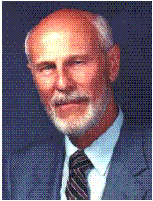
Dave Hunt
“Kingdom/Dominion Theology – Part 1” (February 1, 1987), accessed July 12, 2015, https://www.thebereancall.org/content/kingdomdominion-theology-part-i.
“There are many factors that make up the growing apostasy and seduction of the church. One of the most alarming, least understood, and fastest spreading errors is the teaching that earth instead of heaven is the ultimate home for the church, and that her goal is to take over the world and establish the kingdom of God. Only then, it is said, can Christ return—not, however, to take us to His Father’s house as He promised His disciples in John 14, but to reign over the Kingdom which we have established for Him. . . . [I]f the real Jesus Christ is going to catch His bride up from earth to meet Him in the air (1 Thess. 4:17), then those who work to build a kingdom for a ‘Christ’ whom they will meet with their feet planted on earth have been under heavy delusion indeed! They have been working for the Antichrist!”

Slide 42
8 Ways Kingdom Now Theology Impacts the Church
Loss of “pilgrim” status
Social Gospel
Ecumenical & interfaith alliances
Rejection or marginalization of Bible prophecy
Building the wrong kingdom
Charismatic theology
Prosperity Gospel
Anti-Israelism

Slide 43
The 7 Disputed Gifts
Apostle
Prophet
Worker of Miracles
Tongues
Interpretation of tongues
Healing
Knowledge

Slide 44
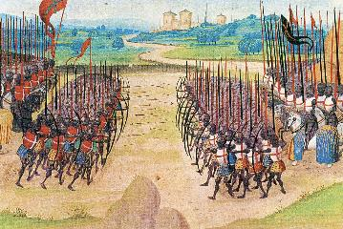
Two Camps
Charismatics – All the spiritual gifts are in operation today
Cessationists (selective)– Most of the spiritual gifts are in operation today

Slide 45

Isaiah 35:5-6
“⁵ Then the eyes of the blind will be opened And the ears of the deaf will be unstopped. ⁶ Then the lame will leap like a deer, And the tongue of the mute will shout for joy. For waters will break forth in the wilderness And streams in the Arabah.”

Slide 46

John Wimber
John Wimber and Kevin Springer, Power Evangelism (Bloomington, MN: Chosen, 2009), 19.
“I was already acquainted with George Eldon Ladd’s writings (he was a Fuller Theological Seminary professor), but it was not until I read his book Jesus and the Kingdom that I realized how his work on the kingdom formed a theological basis for power evangelism. As I read Dr. Ladd’s works, and then read afresh the gospel accounts, I became convinced that power evangelism was for today.”

Slide 47
8 Ways Kingdom Now Theology Impacts the Church
Loss of “pilgrim” status
Social Gospel
Ecumenical & interfaith alliances
Rejection or marginalization of Bible prophecy
Building the wrong kingdom
Charismatic theology
Prosperity Gospel
Anti-Israelism

Slide 48

Amos 9:13
“Behold, days are coming,” declares the Lord, “When the plowman will overtake the reaper And the treader of grapes him who sows seed; When the mountains will drip sweet wine And all the hills will be dissolved.”

Slide 49
Isaiah 35:5-6
“⁵ Then the eyes of the blind will be opened And the ears of the deaf will be unstopped. ⁶ Then the lame will leap like a deer, And the tongue of the mute will shout for joy. For waters will break forth in the wilderness And streams in the Arabah.”

Slide 50
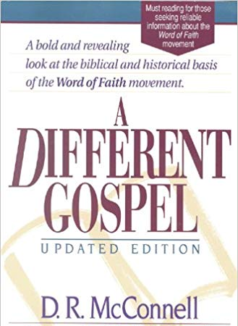
D.R. McConnell
A Different Gospel: A Bold and Revealing Look at the Historical Basis of the Word of Faith Movement, Updated and electronic ed. (Peabody, MA: Hendrickson, 2011), loc. 4813–4846.
“The Faith teachers deny that the kingdom of God is in the process of realization, claiming that it is present in the earth to the point that believers can be delivered from all sin, sickness, and poverty of the devil. They . . . claim that the believer has absolute authority to conquer and eradicate these forces of evil completely from his life. The only process of realization is in the faith of the believer, not in the presence of God’s kingdom. In the jargon of biblical theology, the Faith interpretation of the kingdom of God could be labeled as a ‘hyper-realized’ eschatology.”

Slide 51

Galatians 4:13-14
“¹³ but you know that it was because of a bodily illness that I preached the gospel to you the first time; ¹⁴ and that which was a trial to you in my bodily condition you did not despise or loathe, but you received me as an angel of God, as Christ Jesus Himself.”

Slide 52

Revelation 2:9
“I know your tribulation and your poverty (but you are rich), and the blasphemy by those who say they are Jews and are not, but are a synagogue of Satan.”

Slide 53
8 Ways Kingdom Now Theology Impacts the Church
Loss of “pilgrim” status
Social Gospel
Ecumenical & interfaith alliances
Rejection or marginalization of Bible prophecy
Building the wrong kingdom
Charismatic theology
Prosperity Gospel
Anti-Israelism

Slide 54
Alva J. McClain
Alva J. McClain, The Greatness of the Kingdom: An Inductive Study of the Kingdom of God as Set Forth in the Scriptures (Grand Rapids: Zondervan, 1959), 438.
“The confusion of our . . . Lord’s rule . . . leads to serious consequences. . . . [I]t makes the present age the period of the Mediatorial Kingdom. . . . [I]t dissolves the divinely covenanted purpose in the nation of Israel.”

Slide 55
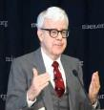
Gary North
Gary DeMar and Gary North quotes, can be found in H. Wayne House and Thomas Ice, Dominion Theology: Blessing or Curse? (Portland, OR: Multnomah, 1988), 409–11.
“The goal of establishing Christ’s international kingdom can be presented to citizens of any nation.”…“Christians are required to become active in the building God’s visible kingdom.”…“If the Christian church fails to build the visible kingdom by means of biblical law and the power of the gospel, despite the resurrection of Christ and the presence of the Holy Spirit, then what kind of religion are we preaching?”…“The parable (Matt. 13:24–30, 36–43) refers to the building of the kingdom of God, not simply to the institutional church.”

Slide 56

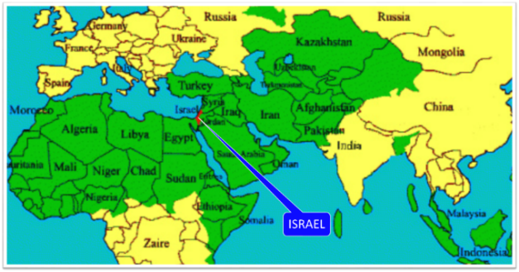
Thomas Ice
Personal letter from Gary North to Peter Lalonde, April 30, 1987 on file; cited in Thomas Ice, “Answering Those Who Oppose Israel,” 1, accessed October 21, 2015, http://www.pre-trib.org.
Thomas Ice reports, “Gary North has boasted that he has a book already in his computer for when ‘Israel gets pushed into the sea, or converted to Christ.’”

Slide 57
Conclusion

Slide 58
8 Ways Kingdom Now Theology Impacts the Church
Loss of “pilgrim” status
Social Gospel
Ecumenical & interfaith alliances
Rejection or marginalization of Bible prophecy
Building the wrong kingdom
Charismatic theology
Prosperity Gospel
Anti-Israelism

