Slide 1
The Bible and Borders
What Does the Bible Say About Borders and Immigration?

Slide 2
My goal
I Will Not:
Provide the “Sunday School” Answer to a Difficult Problem
Attempt to Minimize the Complexity
Ridicule The Viewpoint of Others
I Will:
Explore What the Bible Says About Borders and Migrants
Identify Some Biblical Guidelines or Principles That Guide Us
Recognize That Everyone Involved in this Discussion is Made in God’s Image and are Therefore Worthy of Respect

Slide 3
The Plan
Some Presuppositions or Assumptions
What Does the Bible Say About Borders?
What Does the Bible Say About Immigrants?
What Are Some Biblically Based Principles We Can Apply?

Slide 4
Biblical and Systematic Theology
A Consistent and Literal
Hermeneutic Is Required
To Interpret The Bible
(Mt. 22:32, 43—45, Gal. 3:16)
Without God’s Help We Can’t
Understand The Bible
(1 Cor. 2:12, 1 Jn. 2:27)
The God of the Bible Exists
(Prov. 1:7)
God Has Revealed Himself
In the Bible
(2 Tim. 3:16)
Foundations of a Biblical and Systematic Theology
Four Pillars Support a Biblically Based Theology

Slide 5
The Bible and Borders
Everyone Seems to Be Looking in the Bible For an Answer
This Just Adds to the Confusion, Frustration, and Anger

Slide 6
The Bible and Borders
Everyone Seems to Be a Bible Reader These Days
Both Political Parties Seem to Be Trying to Back Up Their Point of View Using the Bible!
But What Does the Bible Really Say?
—Quite A Lot!
Borders, Boundaries, or Nation is Mentioned More Than 800 Times, Foreigners More Than 200 Times
Doesn’t Include Instances Where One of These Things Are Implied

Slide 7
Borders In The Bible
A Lot of Discussion in the Bible About Borders
Borders Seem To Be Established For the Good of Man
Borders Become a Source of Conflict and Human Tragedy
But Also a Way to Bring God Honor

Slide 8
Mankind Was to Rule the Earth
“Then God said, “Let us make man in our image, after our likeness. And let them have dominion over the fish of the sea and over the birds of the heavens and over the livestock and over all the earth and over every creeping thing that creeps on the earth.” So God created man in his own image, in the image of God he created him; male and female he created them. And God blessed them. And God said to them, “Be fruitful and multiply and fill the earth and subdue it, and have dominion over the fish of the sea and over the birds of the heavens and over every living thing that moves on the earth.”” (Genesis 1:26–28)

Slide 9
Earliest Reference to a “Border”
“therefore the Lord God sent him out from the garden of Eden to work the ground from which he was taken. He drove out the man, and at the east of the garden of Eden he placed the cherubim and a flaming sword that turned every way to guard the way to the tree of life.” (Genesis 3:23–24)
Here God Sets Up a Border Enclosing the Garden of Eden
Installs an Armed Border Guard
Why Did God Do This?
What Right Does God Have to Do This?

Slide 10
First Mention of “Nation”
From these the coastland peoples spread in their lands, each with his own language, by their clans, in their nations.” (Genesis 10:5, ESV)
The Nations Developed From Groups With Common Language
The Nations Developed From Family Groups
We Also Find Out That Translations Don’t Help!

Slide 11
First Mention of “Nation”
By these were the isles of the Gentiles divided in their lands; every one after his tongue, after their families, in their nations. (Genesis 10:5, KJV)
From these the coastlands of the nations were separated into their lands, every one according to his language, according to their families, into their nations. (Genesis 10:5, NASB)
From these the coastland peoples spread in their lands, each with his own language, by their clans, in their nations.” (Genesis 10:5, ESV)

Slide 12
The Difference Between Nations and Peoples
גּוֹי goy
Nation
Designates a National Entity or a Political Unity
Used in Gn. 10:5, 20, 31, 32 to Describe the Nations Formed From Noah’s Son
A Nation in the Bible is Characterized By Borders, a Central Government, a Governing Establishment, Common Laws
עַם am
People
Designates a Group of People
Focused on the Common Ancestry

Slide 13
First Mention of “Nation”
By these were the isles of the Gentiles (goy)divided in their lands; every one after his tongue, after their families, in their nations (goy). (Genesis 10:5, KJV)
From these the coastlands of the nations (goy)were separated into their lands, every one according to his language, according to their families, into their nations (goy). (Genesis 10:5, NASB)
From these the coastland peoples (goy) spread in their lands, each with his own language, by their clans, in their nations (goy).” (Genesis 10:5, ESV)

Slide 14
Spread of Nations
“And the Lord said, “Behold, they are one people, and they have all one language, and this is only the beginning of what they will do. And nothing that they propose to do will now be impossible for them. Come, let us go down and there confuse their language, so that they may not understand one another’s speech.” So the Lord dispersed them from there over the face of all the earth, and they left off building the city. Therefore its name was called Babel, because there the Lord confused the language of all the earth. And from there the Lord dispersed them over the face of all the earth.” (Genesis 11:6–9)

Slide 15
Creation of Nations
God Again Intervenes and Separates People Into Groups Which Then Became Nations
Why Did God Do This?
How is this Similar to What Happened in Eden?
How is this Different From What Happened in Eden?

Slide 16
What Can We Learn?
Why Were Borders Set Up In Eden?
Why Were Nations Established at Babel?
Does it Seem God Separates People to Curb the Spread and Limit the Impact of Sin?
Principle #1: God Has Established National Borders to Limit the Spread and Impact of Sin

Slide 17
Boundaries and Borders Are evident
“Terah took Abram his son and Lot the son of Haran, his grandson, and Sarai his daughter-in-law, his son Abram’s wife, and they went forth together from Ur of the Chaldeans to go into the land of Canaan, but when they came to Haran, they settled there.” (Genesis 11:31)
By The Next Chapter in Genesis There Are Definite and Distinguishable Geographic Areas
These Are Places You Can Find on a Map

Slide 19
God Disrupts Borders and Displaces Nations
““When the Lord your God brings you into the land that you are entering to take possession of it, and clears away many nations before you, the Hittites, the Girgashites, the Amorites, the Canaanites, the Perizzites, the Hivites, and the Jebusites, seven nations more numerous and mightier than you,” (Deuteronomy 7:1)
““Hear, O Israel: you are to cross over the Jordan today, to go in to dispossess nations greater and mightier than you, cities great and fortified up to heaven,” (Deuteronomy 9:1)
“When the Most High gave to the nations their inheritance, when he divided mankind, he fixed the borders of the peoples according to the number of the sons of God.” (Deuteronomy 32:8)

Slide 20
God Disrupts Borders and Displaces Nations—But Why?
And he made from one man every nation of mankind to live on all the face of the earth, having determined allotted periods and the boundaries of their dwelling place, that they should seek God, and perhaps feel their way toward him and find him. Yet he is actually not far from each one of us, (Acts 17:26–27)
Borders Change Over Time
What We Face Today is Part of an Ongoing Plan
Can Anyone Doubt That the Collapse of the Soviet Union and Yugoslavia Were Not an Instance of Principle #1?

Slide 21
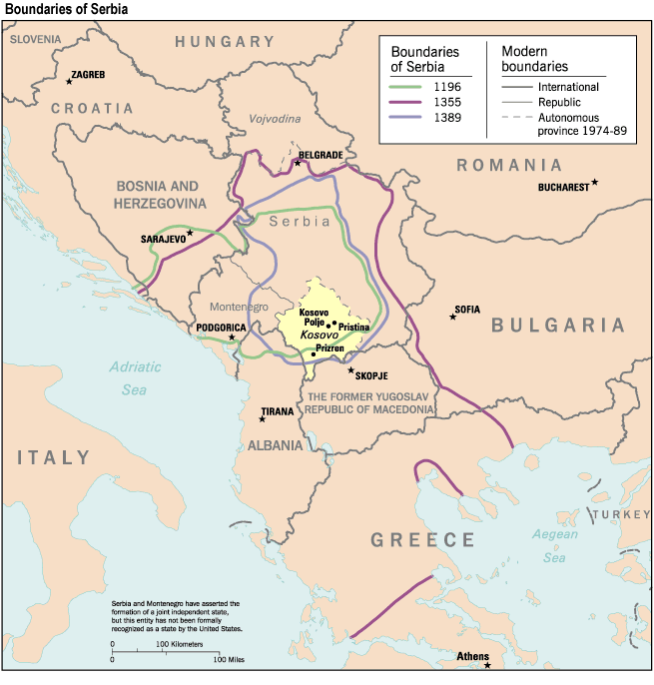
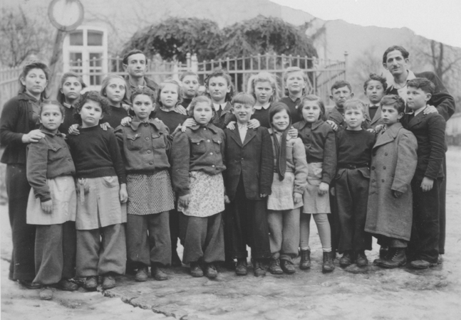
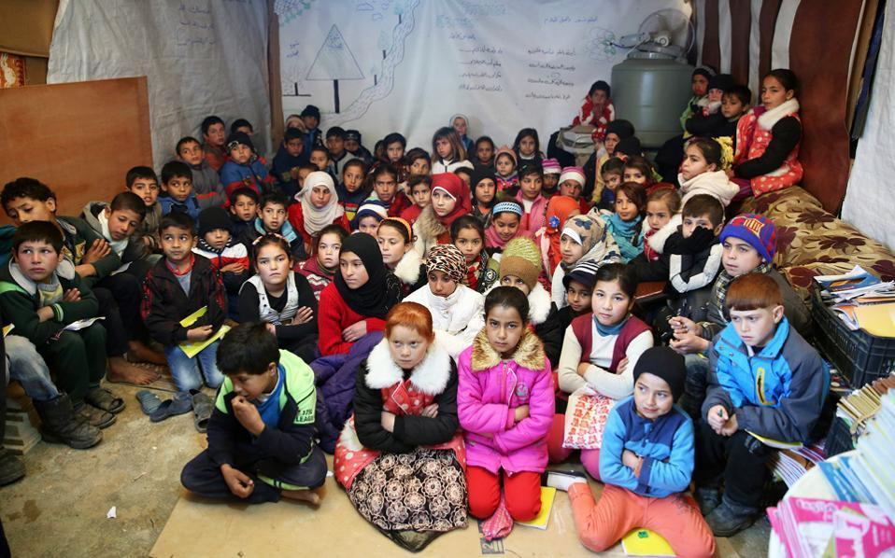
After WWII There Were Up to 11 Million People Displaced
We Witness Ongoing Changes to Borders Today
Yugoslavia
Soviet Union
In the Croatian War of Independence (1991-1995) 400,000 People Were Displaced
Christianity Played a Decisive Role
“Christianity Ended the Cold War Peacefully”—The Guardian

Slide 22
What Can We Learn?
What Disrupts Borders Between Nations?
What is the Human Impact of Border Disruption?
Why Does God Disrupt Borders?
Why Do Border Disruptions Cause People to Search for God?
Principle #2: God Disrupts Borders and Displaces People So They Will Search For Him

Slide 23
Nations Will Exist in Eternity
They will bring into it the glory and the honor of the nations. (Revelation 21:26)
through the middle of the street of the city; also, on either side of the river, the tree of life with its twelve kinds of fruit, yielding its fruit each month. The leaves of the tree were for the healing of the nations. (Revelation 22:2)
Nations Will Continue to Exist in Eternity
They Will Have Wealth (Rev. 21:26), and They Will Enjoy “healing” i.e. physical well being, peace, security, justice
Principle #3: In Eternity Nations Will Honor God

Slide 24
Summary
Principle #1: God Has Established National Borders to Limit the Spread and Impact of Sin
Principle #2: God Disrupts Borders and Displaces People So They Will Search For Him
Principle #3: In Eternity Nations Will Honor God

Slide 25
Foreigners In The Bible
Foreigners to Israel
Several Categories of Foreigners
Depended on the Degree of Identification/Assimilation With Israel
Ranged From Full Identification With Israel’s God and Spiritual Values to Those Who Had Social and Political Contact But Refused Anything Closer
Translators Again Don’t Help, They Are Inconsistent So We Will Examine the Hebrew Words

Slide 26
Need to pay Attention to Original Language
גֵּר ger (92x)
Sojourner/Stranger
A Person From a Foreign Nation Who Was a Temporary Resident
Fully Embraced Israelite Culture and Religion
With Exceptions Given the Rights of Natural Citizens
נָכְרִי nakhri (35x)
Foreigner
A Person From a Foreign Nation Who Was a Non-Resident
Maintained Ethnic and Religious Distinction Within Israel
Rights Were Restricted

Slide 27
Need to pay Attention to Original Language
זור zwr (70x)
Stranger/Outsider
Someone Outside the Nation
Maintained Ethnic and Religious Distinction Within Israel Who is Reaping the Benefits of the Country
Viewed With Suspicion, Even Revulsion
תּוֹשָׁב toshav (13x)
Sojourner
Rarely Used and Always With Another Word
Embraced Israelite Culture and Religion
Due to Rare Usage the Meaning is Not Clear
Seems to be Very Similar to the גֵּר ger

Slide 28
Israel As Sojourner/Stranger (גֵּר ger)
Abraham, Isaac, and Jacob Were Strangers in Foreign Lands (1 Chr. 16:19, Ps. 105:12)
Could Only Settle With Permission of Local Ruler (Gn. 20:1, 15)
Had Very Few Rights (Gn. 21:23ff, 23:1-10)
Time of Israel’s Oppression in Egypt Was Viewed as a Time of Sojourning (Gen. 47:4, 11; Ex. 22:21; 23:9; Lev. 19:34; Dt. 10:19; 23:7; 26:5; Ps. 105:23; Isa. 52:4
The Sojourning of the Patriarchs and Israel Was to Inform and Temper Their Treatment of Foreigners: They Were Not to Treat Foreigners As They Were Treated

Slide 29
What Can We Learn?
How Would You Define Empathy?
How Does Similar Experience Lead to Empathy?
Can You Vicariously Experience the Difficulties of Immigration?
Principle #4: God Intends Us to Have Empathy for Immigrants

Slide 30
Sojourner/Stranger (גֵּר ger) Within Israel
Fully Embraced Israelite Culture and Religion
Their Rights Were Protected
Could Not Be Economically Exploited (Dt. 24:14-15)
Could Not Be Deprived of Legal Rights (Dt. 24:17, Nu. 35:15, Josh. 20:9)
Could Not Be Barred From Receiving Charitable Donations (Dt. 24:19-21)
Would Receive Money From Triennial Tithe (Dt. 26:11ff)
Had to Obey Israel’s Laws Concerning Sabbath (Ex. 20:10) and Feast of Weeks (Dt. 16:9-12), and Booths (Dt. 16:114)
Were to Be Treated as a Native Israelite (Lev. 19:33)
Sometimes Also Called a נתּוֹשָׁב (toshav)

Slide 31
Foreigner (נָכְרִי nakhri)
Maintained Ethnic and Religious Distinction Within Israel
Their Sacrificial Animals Were Unacceptable (Lev. 22:25)
Could not Participate in the Passover (Ex. 12:43)
Debts of Israelites Were Forgiven Every Seven Years, But Not the Debts of the Foreigner (Dt. 15:1-3)
Interest Could Be Collected From them (Dt. 23:20)
Viewed with Suspicion (Ps. 144:7-11)
Marriage to a Foreigner Was Discouraged (Ezr. 9:2)
Viewed as a Threat to Israelite Life and Worship (Zeph. 1:8, Mal. 2:11)

Slide 32
Sojourner (זור zwr)
Maintained Ethnic and Religious Distinction Within Israel Who is Reaping the Benefits of the Country
Israel is Warned that Jerusalem is Not To Be Defiled By Them (Joel 3:17)
Used to Describe the ”Strange” Fire Offered by Nadab and Abihu (Lev. 10:1)
Characterized As Greedy Creditors Seizing Property (Ps. 109:11, Prov. 6:1, 11:15, 14:10, 20:16)
Outsiders Who Steal (Prov. 5:10)
A Vengeance Seeking Stranger (Ps. 54:3)

Slide 33
What Can we learn?
What Distinguished Between the Different Types of Immigrants?
Did All Types of Immigrants Have All the Rights of a Native-Born Israelite?
What Might Have Been the Impact on Israel If Differences Among Immigrants Was Not Observed?
Principle #5: Discerning the Motive and Intention of an Immigrant is Acceptable to God
Principle #6: Regulating the Privileges Extended to an Immigrant is Acceptable to God

Slide 34
What About the New Testament?
Jews (Jn. 7:35), and Christians (1 Pet. 1:1, 2:11) Viewed Themselves as Living as Foreigners
Christians Were Instructed to Have Integrity, Submit to Government Authority, Be Disciplined in Their Behavior, and Help Fellow Sojourners (1 Pet. 2:11ff)
But The Jewish Attitude Toward Outsiders Hardened:
“They regard the rest of mankind with all the hatred of enemies”—Tacitus, History 5:5

Slide 35
What About the New Testament?
Non-Jews Were Barred From the Temple Under Penalty of Death (Jos. Ant. 14.11.5)
And he (Peter) said to them, “You yourselves know how unlawful it is for a Jew to associate with or to visit anyone of another nation, but God has shown me that I should not call any person common or unclean.” (Acts 10:28)
Jews and Christians Had Significantly Different Attitudes Toward Non-Jews
Distinctions Among Foreigners Based on Motive or Intent Within The Nation of Israel Were Replaced By Purely Ethnic Separation and Superiority
The Christian Gospel Was Not To Be Limited by Borders or Ethnicity

Slide 36
What Can We Learn?
What is the Difference Between the Nation of Israel in the Hebrew Scriptures, and the Jews in the New Testament?
How Did This Contribute to a Hardening of Attitudes Toward Foreigners?
In this Context, Why Was Christianity so Disruptive and Rejected by the Jews?
Principle #7: The Message and Impact of the Gospel Knows No Border and is Stopped by No Prejudice
Principle #8: Christians Are to Live Within The Laws of Their Country

Slide 37
So What Have We Learned?
Principle #1: God Has Established National Borders to Limit the Spread and Impact of Sin
Principle #2: God Disrupts Borders and Displaces People So They Will Search For Him
Principle #3: In Eternity Nations Will Honor God
Principle #4: Principle #4: God Intends Us to Have Empathy for Immigrants
Principle #5: Discerning the Motive and Intention of an Immigrant is Acceptable to God
Principle #6: Regulating the Privileges Extended to an Immigrant is Acceptable to God
Principle #7: The Message and Impact of the Gospel Knows No Border and is Stopped by No Prejudice
Principle #8: Christians Are to Live Within The Laws of Their Country

