Slide 1
The Title/Name “Son of God”: Divine and Human
Mike Stallard

Slide 2
General Understanding in Church History
SON OF GOD = DEITY OF CHRIST
SON OF MAN = HUMANITY OF CHRIST
THESIS:
While this is sometimes true in Scripture, it is an overly
simplistic grid by which to think about these terms in most passages.

Slide 3

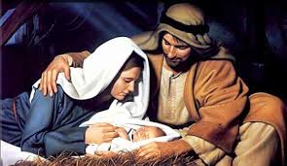
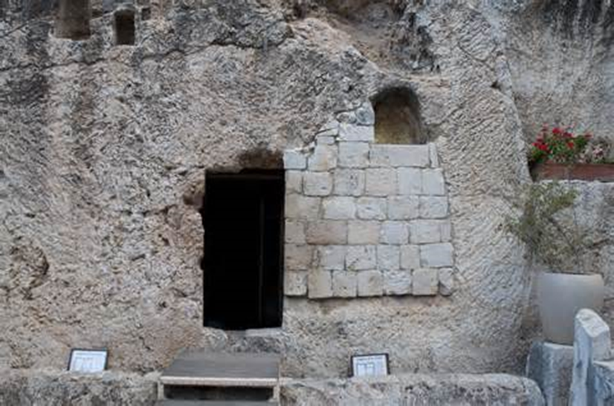

Four Ways Jesus is Called the Son of God
By virtue of His eternal relationship with the Father in the Godhead
John 17
Rev. 22:1
By virtue of the Incarnation
Luke 1:35
By virtue of the resurrection
Romans 1:4
By virtue of being the coming Davidic king of Israel
(see list)

Slide 4
Which one gets most attention in Church history?
By virtue of His eternal relationship with the Father in the Godhead
John 17
Rev. 22:1
By virtue of the Incarnation
Luke 1:35
By virtue of the resurrection
Romans 1:4
By virtue of being the coming Davidic king of Israel
(see list)

Slide 5
Which one gets most attention in Church history?
By virtue of His eternal relationship with the Father in the Godhead
John 17
Rev. 22:1
By virtue of the Incarnation
Luke 1:35
By virtue of the resurrection
Romans 1:4
By virtue of being the coming Davidic king of Israel
(see list)

Slide 6
Which one gets most attention in the Bible?
By virtue of His eternal relationship with the Father in the Godhead
John 17
Rev. 22:1
By virtue of the Incarnation
Luke 1:35
By virtue of the resurrection
Romans 1:4
By virtue of being the coming Davidic king of Israel
(see list)

Slide 7
Which one gets most attention in the Bible?
By virtue of His eternal relationship with the Father in the Godhead
John 17
Rev. 22:1
By virtue of the Incarnation
Luke 1:35
By virtue of the resurrection
Romans 1:4
By virtue of being the coming Davidic king of Israel
(see list)

Slide 8
Why did the Church throughout history emphasize the first category (Son of God = Deity) rather than the last category (Son of God = King of Israel)?
Thirteen or more centuries of amillennial domination and replacement theology which had no use for the nation of Israel

Slide 9
Many times this is the what you find in Scripture…
Son of God =
Son of Man =
Messiah =
Christ =
King of Israel

Slide 10
2 Samuel 7:14
(God speaking of Solomon who was to be born later)
“I will be a father to him and he will be a son to Me.”

Slide 11
Psalm 2:7
I will surely tell of the decree of the LORD:
He said to Me, ‘Thou art My Son,
Today I have begotten Thee.’
I see this as parallel to Psalm 2:6 –
But as for Me, I have installed My King
Upon Zion, My holy mountain

Slide 12
Psalm 89:26-27
(God speaking of King David)
26 “He will cry to Me, ‘Thou art my Father,
My God, and the rock of my salvation.’
27 “I also shall make him My first-born,
The highest of the kings of the earth.”

Slide 13
Hebrews 1:5
This passage brings together two passages from the Old Testament to prove Jesus is superior to the angels.
For to which of the angels did He ever say, “Thou art My Son, today I have begotten Thee? – from Ps 2:7
And again, “I will be a father to Him, and He shall be a Son to Me”? -- from 2 Sam. 7:14
The issue seems to be kingship.

Slide 14
Matthew 16
16:16 And Simon Peter answered and said, “Thou art the Christ, the Son of the living God.”
Is Peter saying Jesus is two things or one thing?
What does the term Christ mean?
16:28 “Truly I say to you, there are some of those who are standing here who shall not taste death until they see the Son of Man coming in His kingdom.”
Notice the new term in the context of kingdom.

Slide 15
Mark 14
14:61 Again the high priest was questioning Him, and saying to Him, “Are You the Christ, the Son of the Blessed One?”
14:62 And Jesus said, “I am; and you shall see the Son of Man sitting at the right hand of power, and coming with the clouds of heaven.” (note Daniel 7)
Three terms in context: Christ, Son of God, Son of Man
Is Jesus two separate things in the high priest’s question?

Slide 16
John
1:49 Nathanael answered Him, “Rabbi, You are the Son of God; You are the King of Israel.”
Is he saying Jesus is one thing or two things?
12:34 The multitude therefore answered Him, “We have heard out of the Law that the Christ is to remain forever; and how can You say, “The Son of Man must be lifted up”? Who is this Son of Man?
Christ = Son of Man?

Slide 17
How Careful Are We in Our Interpretation?
By virtue of His eternal relationship with the Father in the Godhead
John 17
Rev. 22:1
By virtue of the Incarnation
Luke 1:35
By virtue of the resurrection
Romans 1:4
By virtue of being the coming Davidic king of Israel
(see list)

